Slide 1
Terminal App
DuyNguyenT1A3

Slide 2
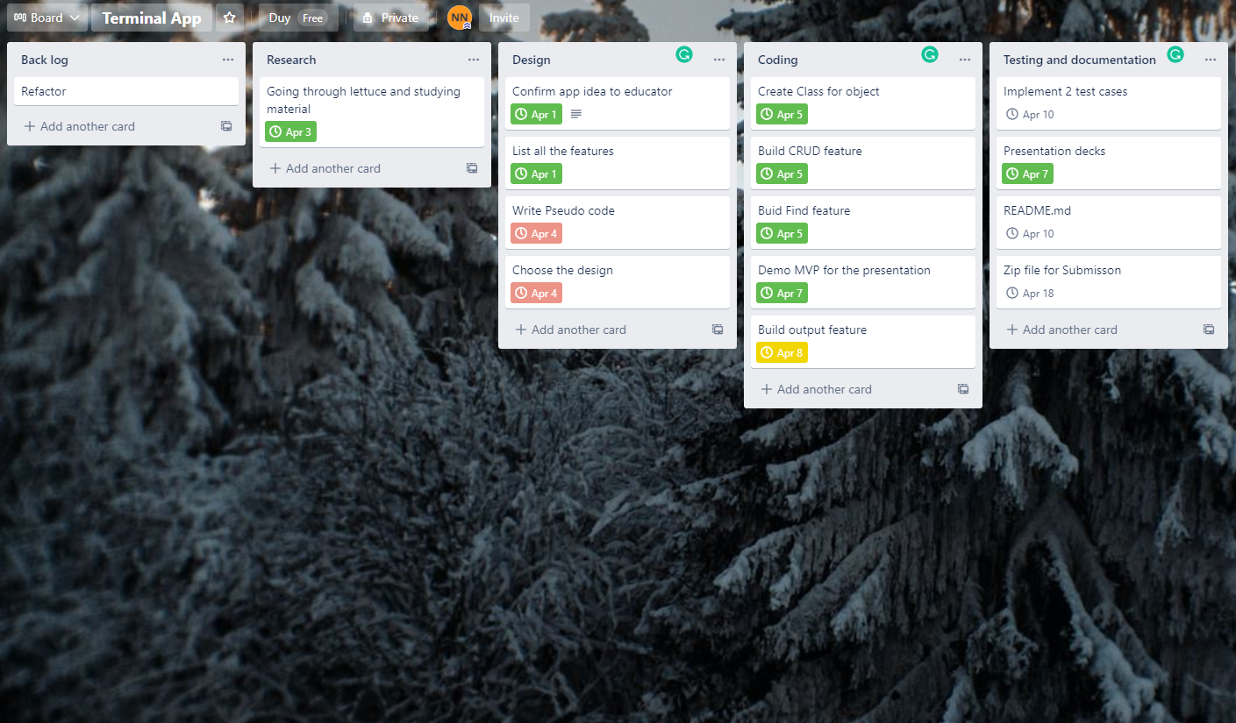


Trello

Slide 3
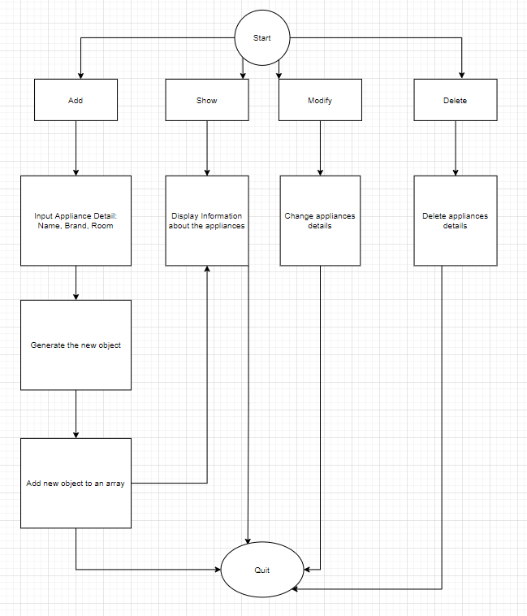
Flow chart

Slide 4

Feature
- CRUD
- FIND Appliances
- Nice output

Slide 5
Development
Challenges
Ethical
Favourite

Slide 6

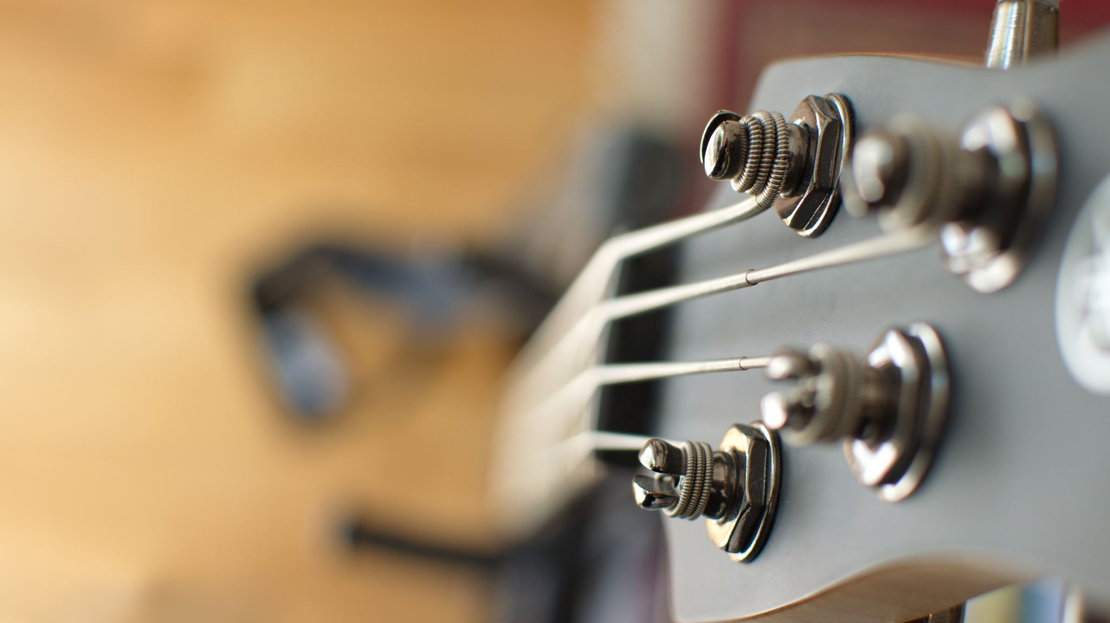

Demo
MVP

